Slide 1
Correlation vs Causation

Slide 2


Slide 3
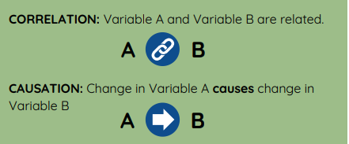
Correlation, yes. But causation…?
Variables can be linked without one causing the other.

Slide 4
Two Types of Data
Quantitative
Numerical
Can be put in order (least to greatest)
Can be continuous (unlimited number of values between minimum and maximum)
Categorical
Categories or group labels
Does not have a certain order
Can be represented by numbers in certain situations

Slide 5
Quantitative or Categorical?
Hair color
Temperature
Gender
ZIP code

Slide 6
Quantitative or Categorical?
Hair color: Categorical
Temperature: Quantitative
Gender: Categorical
ZIP code: Categorical

Slide 7
Contingency Tables

Slide 8
Contingency Table
Explanatory
Variable
 | Southside | Northside
White Sox | Individuals who are Southside and White Sox fans | Individuals who are Northside and White Sox fans | Total White Sox fans
Cubs | Individuals who are Southside and Cubs fans | Individuals who are Northside and Cubs fans | Total Cubs fans
 | Total Southside | Total Northside | Total individuals (Grand total)
Outcome variable
Notes:
we will use something called a contingency table, also known as a two-way table or crosstab to compare the variables. Contingency tables:
Are used to determine if two variables are correlated (is there a link between the two variables?)
Another way to state that is that they can help us determine if the variables are independent of one another or not.
Contingency tables allow us to compare the outcome in one group to that of another group contingent on a condition. The condition is the potential explanation that you want to explore. In this case the condition is the Chicago side

Slide 9
Results of Student Survey
Link to Forms Results:
Responses Table

